Slide 1
AdaBoost
youtube channel – Veena Sarda
https://www.youtube.com/channel/UCCj2OoEe5iG1tei3Y2eTNBA

Slide 2
Boosting
An iterative procedure to adaptively change distribution of training data by focusing more on previously misclassified records
  Initially, all N records are assigned equal weights
  For Boosting the observations are weighted and therefore some of them will take part in the new sets more often.
  Boosting builds the new learner in a sequential way
  In the case of Bagging, any element has the same probability to appear in a new data set.
  In Bagging each model is built independently

Slide 3
Boosting
In Boosting algorithms each classifier is trained on data, taking into account the previous classifiers’ success.
After each training step, the weights on training data is redistributed.
Records that are wrongly classified will have their weights increased
Records that are classified correctly will have their weights decreased

Slide 4
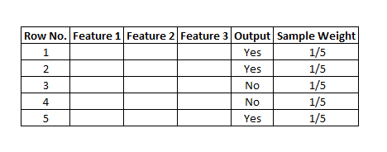
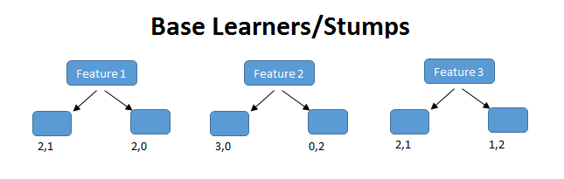
1st weak learner
Here, feature (f1) has classified 2 records correctly and 1 incorrectly.
The row in the figure on next slide that is marked red is incorrectly classified. For this, we will be calculating the total error.

Slide 5
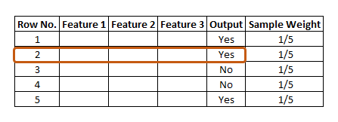
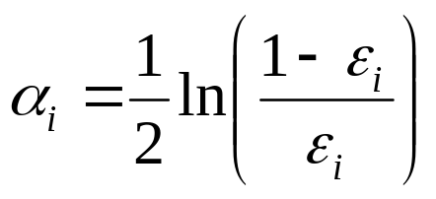
The total error is the sum of all the errors in the classified record for sample weights. In our case, there is only 1 error, so Total Error (TE) = 1/5.
Step 3 – Calculating Performance of Stump
Formula for calculating Performance of Stump is: –
where, ln is natural log and E_{i} is Total Error.
In our case, TE is 1/5. By putting the value of total error in the above formula and after solving, we get the value for the performance of Stump as 0.693.

Slide 6
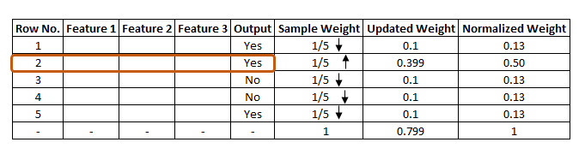
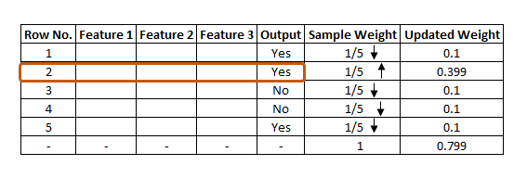
New Sample Weight for misclassified records = Sample Weight * e^(Performance)
In our case Sample weight = 1/5 so, 1/5 * e^ (0.693) = 0.399
New Sample Weight for correct records = Sample Weight * e^- (Performance) = 1/5 * e^-(0.693) = 0.100
Normalize the weights - For example, if our updated weight is 0.399 and we divide this by 0.799, i.e. 0.399/0.799=0.50.
0.50 can be known as the normalized weight. In the below figure, we can see all the normalized weight and their sum is approximately 1.

Slide 7
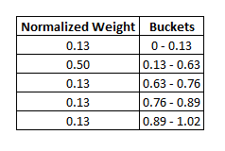
Creating New Dataset
The algorithm will run multiple iterations to select different records from the older dataset.
There is a high probability for the wrong records to get selected several times. This will be the new dataset.
For ex: row number 2 has been selected multiple times from the older dataset if that row is incorrectly classified in the previous dataset.
Process is repeated …

Slide 8
Boosting
In Bagging the result is obtained by averaging the responses of the N learners or majority vote if hard voting.
Boosting assigns a second set of weights, this time for the N classifiers, in order to take a weighted average of their estimates.
The lower a classifier error rate, the more accurate it is, and therefore, the higher its weight for voting should be

Slide 9
Boosting
Equal weights are assigned to each training instance (1/N for round 1) at first round
After a classifier C_{i} is learned, the weights are adjusted to allow the subsequent classifier
C_{i+1} to “pay more attention” to data that were misclassified by C_{i}.
Final boosted classifier C* combines the votes of each individual classifier
  Weight of each classifier’s vote is a function of its accuracy
Adaboost – popular boosting algorithm

Slide 10
Adaboost (Adaptive Boost)
Input:
  Training set D containing N instances
  T rounds
  A classification learning scheme
  An error less than 50% is required to maintain the model; otherwise, the iteration is repeated until achieving a learner better than a random guess.
Output:
  A composite model

Slide 11
Code Time

